Slide 1
SAS® Training
Based on Learning SAS by Example: A Programmer’s Guide
1. Introduction to SAS

Slide 2
What is SAS?
Began as a statistical package
Also allows users to:
Store data
Manipulate data
Create reports
PDF
Excel
HTML
XML
RTF / Word
Etc. Etc. Etc.

Slide 3
What is SAS?
Also allows users to:
Create graphs
Create maps
Send e-mails
Create web applications
Create iPhone Apps
Access R
Schedule regularly run reports
Etc. Etc. Etc.

Slide 4
About these trainings
Created by Tasha Chapman
Originally held in early 2013
Examples created using SAS version 9.2

Slide 5
About these trainings
Material based on Learning SAS by Example: A Programmer’s Guide by Ron Cody
Book is available for state employees using Books 24x7 through the Oregon State Library
Sample code and data files from the book can be found: http://support.sas.com/publishing/authors/extras/60864_code.pdf
Some slides will have a book icon at the corner of the slide with a hyperlink to additional text

Slide 6
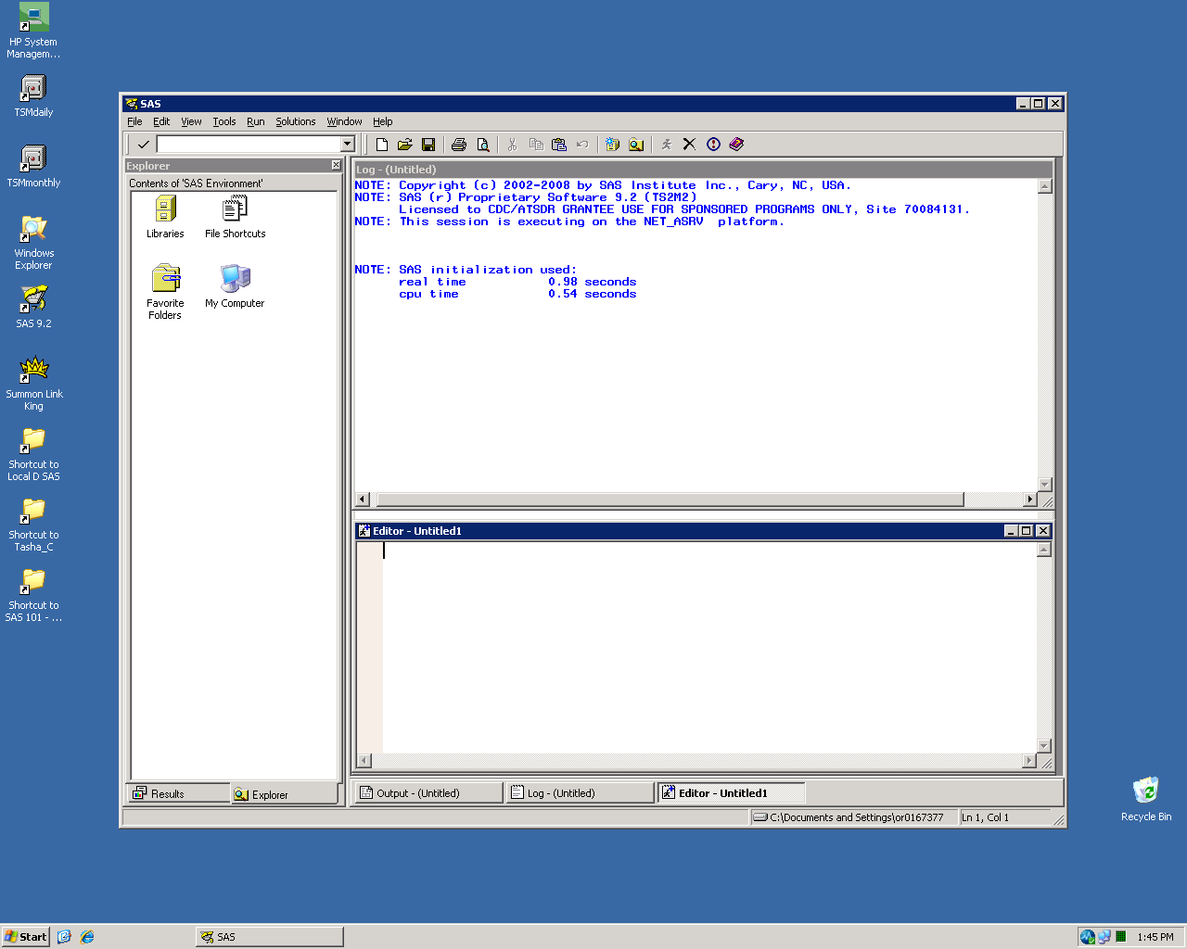
SAS Display Manager
Log:
Details about jobs you’ve run, including error messages
Explorer Window:
See libraries and SAS datasets
Enhanced Editor:
Where you write your SAS code

Slide 7
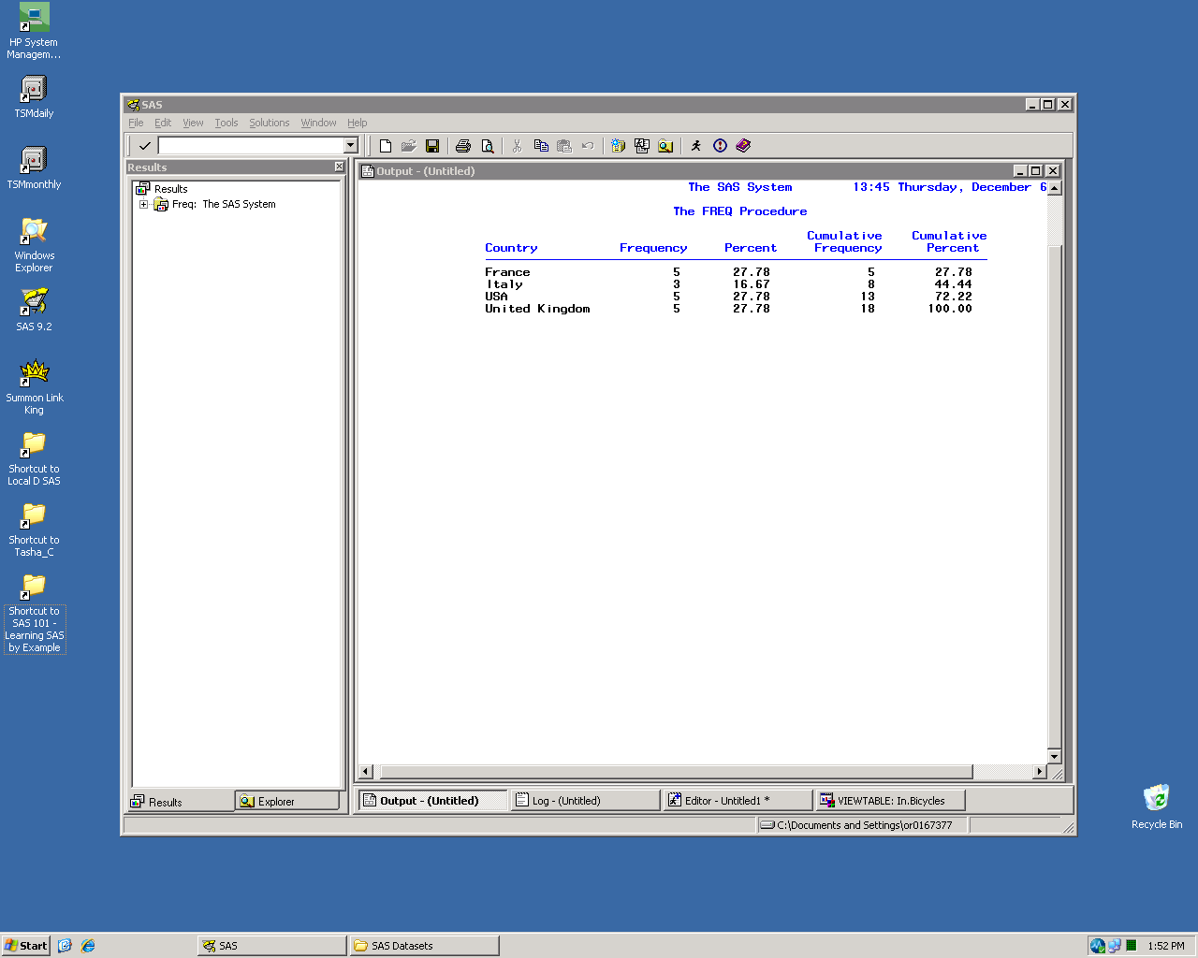
Results tab:
List of previously run results
Output Window:
Basic view of results and output
(Also known as “Listing Destination”)

Slide 8
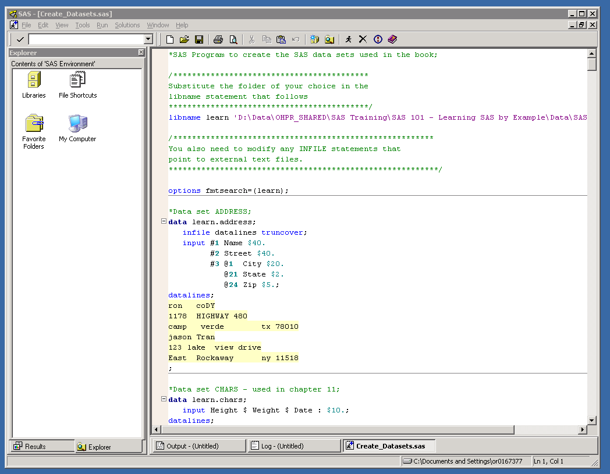
Run:
Submits your SAS code
(“The Running Man”)

Slide 9
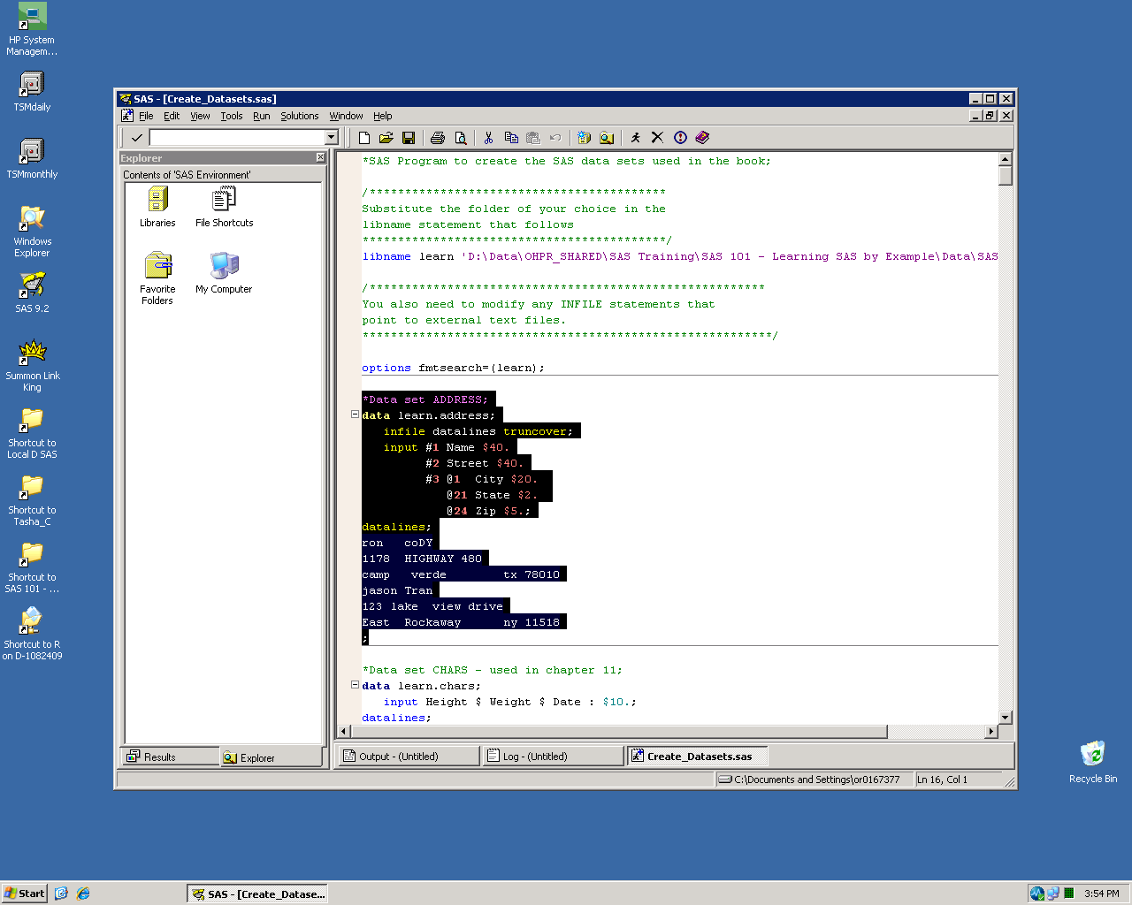
You can submit the program as a whole
or
Run only a portion of highlighted code

Slide 10
Chunks of code will be processed in the order you RUN them, not necessarily in the order you wrote them

Slide 11

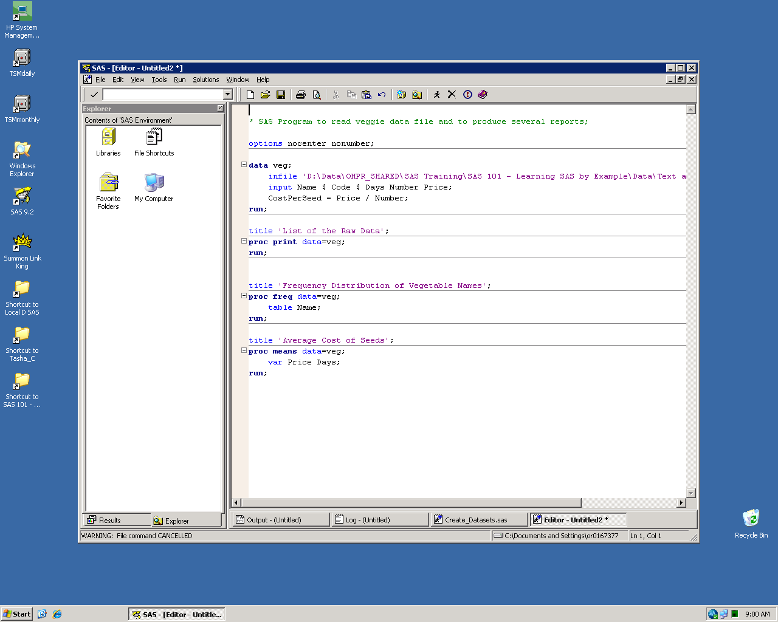
DATA steps:
Read and write data, manipulate data, perform calculations, etc.
Every DATA step creates a new dataset

Slide 12
Every SAS program can have multiple DATA and PROC steps
PROC steps:
Produce reports, summarize data, sort data,
create formats, generate graphs, etc. etc. etc.

Slide 13
Global statements:
Remain in effect until changed by another global statement or SAS session ends
Examples:
Titles, Footnotes, Options, Macros, Libname

Slide 14
Comment statements:
Ignored by SAS when code is run
Used to write comments to yourself or others or
comment out code you don’t want to run
*comment statement;
or
/* comment statement */

Slide 15
Programming in SAS
SAS is generally forgiving
Code can be written on a single line or multiple lines
Code and variable names not case sensitive
Even accepts some misspellings
Fi The Doo
Semicolons are super important
Colors of Enhanced Editor
Always check your log!!!
Often many ways to do the same thing

Slide 16
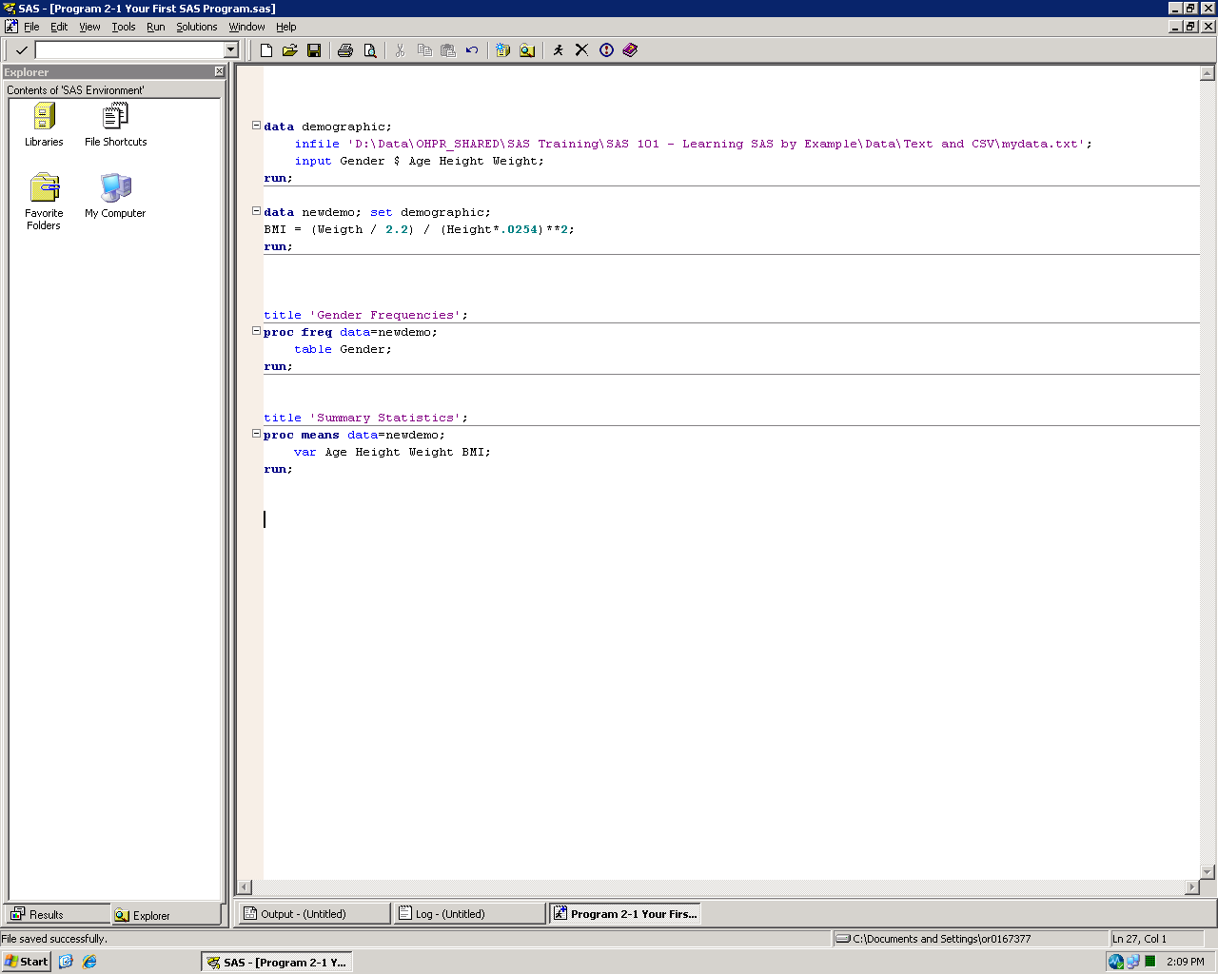
DATA step examples

Slide 17
DATA step examples
DATA demographic
“DATA demographic” creates a dataset called “Demographic”
Infile statement reads the text file with the data
Input statement tells SAS what to name the new variables. $ sign after “Gender” indicates that this is a character variable. The remaining variables are numeric.

Slide 18
DATA step examples
DATA newdemo
“DATA newdemo” creates a dataset called “newdemo”
“SET demographic” references the previous dataset “demographic” as the basis for the new dataset
“BMI =” creates a new variable called “BMI” that is calculated as shown. This is called an assignment statement.

Slide 19

PROC step examples

Slide 20
PROC step examples
PROC freq
Creates a basic frequency table with:
Frequency
Percent
Cumulative Frequency
Cumulative Percent
“DATA=newdemo” references the newdemo dataset
TABLE statement indicates which variable(s) to include
Can use multiple variables and even create cross-tab tables

Slide 21
PROC step examples
PROC means
Creates a basic summary table with:
N
Mean
Std Dev
Minimum
Maximum
Can specify which statistics to use in table
“DATA=newdemo” references the newdemo dataset
VAR statement indicates which variable(s) to include

Slide 22
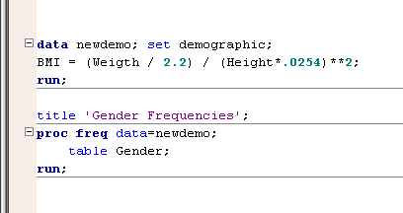
Other notes
Step boundaries:
Each step is executed when a step boundary is encountered
Explicit step boundary: RUN or QUIT statement
Implicit step boundary: Beginning of a new PROC or DATA step
Good SAS programmers use EXPLICIT step boundaries

Slide 23
Other notes
Referencing datasets:
Most procedures and DATA steps reference an existing dataset
Explicit dataset reference: DATA= or SET statement
Implicit dataset reference: If not explicitly referenced, SAS will use the last referenced dataset
Good SAS programmers use EXPLICIT dataset references

Slide 24
SAS Help

Slide 25
http://www.sascommunity.org/wiki/ Learning_SAS_-_Resources_You_Can’t_Live_Without
Where to learn more about SAS
Technical papers
SAS User Groups
Websites
Books
Classes
Popular Websites

Slide 26
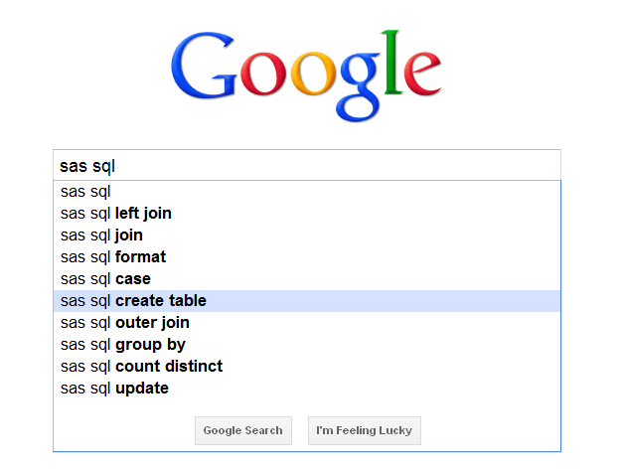
www.google.com
Popular Websites

Slide 27
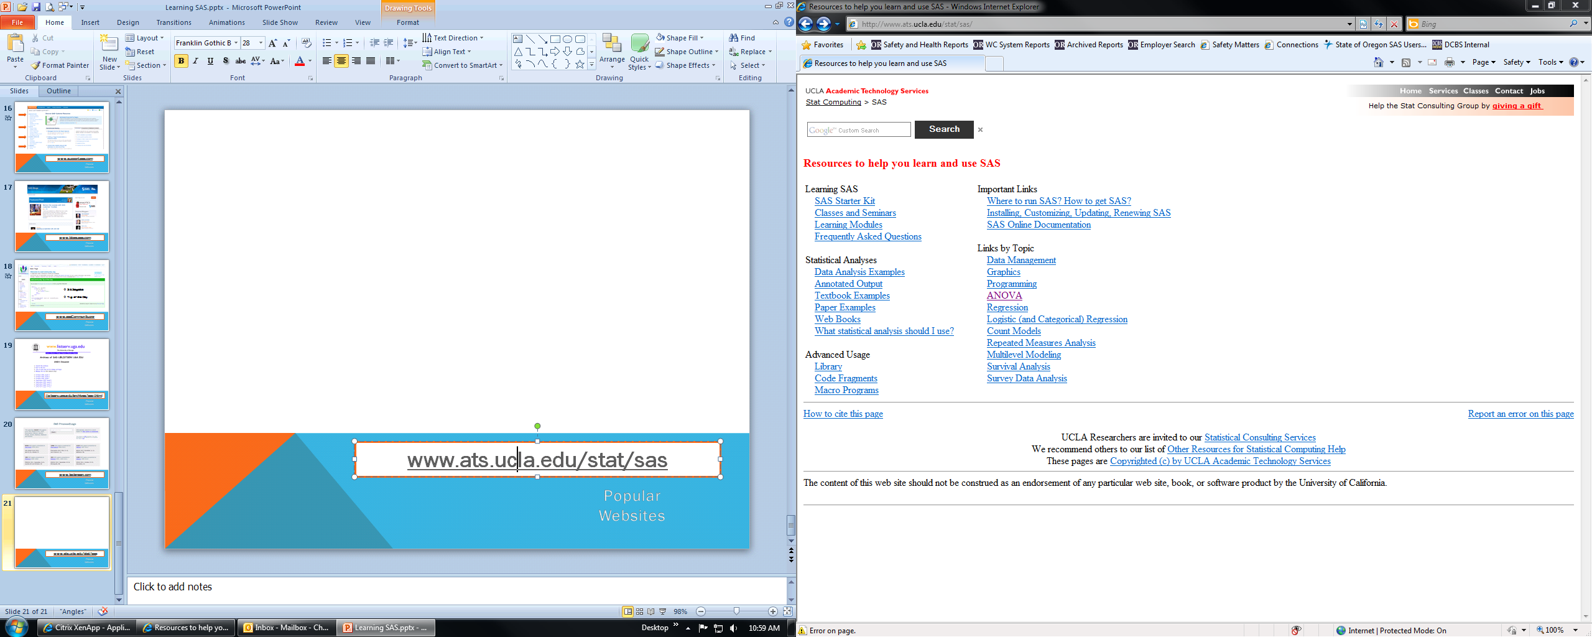
www.ats.ucla.edu/stat/sas
Popular Websites

Slide 28
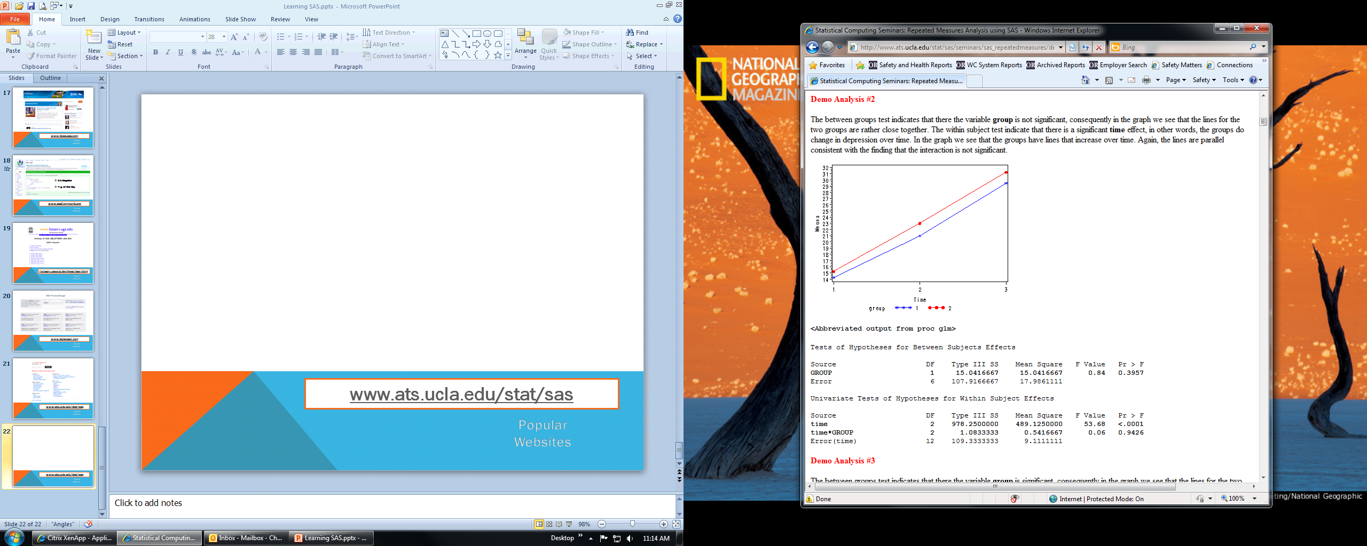
www.ats.ucla.edu/stat/sas
Explains both the stats and the SAS code
Popular Websites

Slide 29
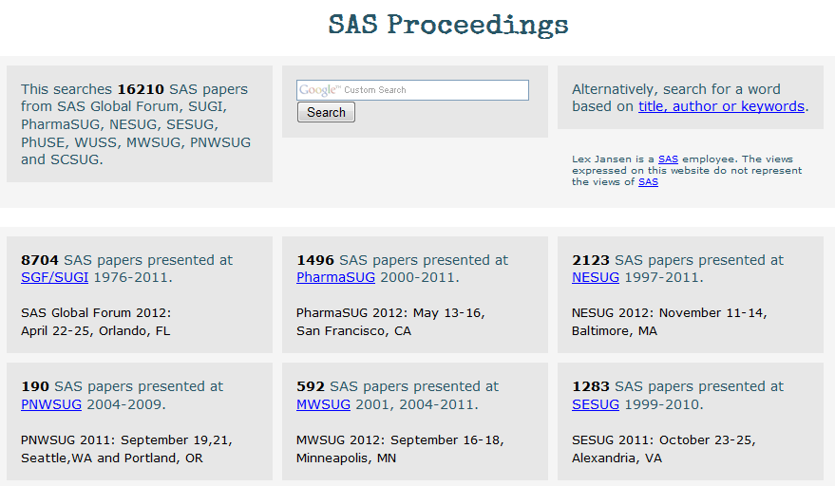
www.lexjansen.com
Popular Websites

Slide 30
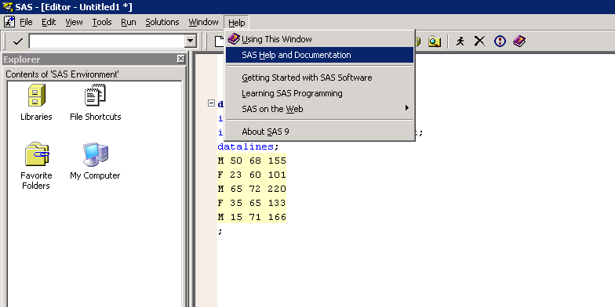
SAS Help and Documentation
Popular Websites

Slide 31
How to read SAS Documentation
DATA output-SAS-data-set
(DROP=variable(s) | KEEP=variable(s));
SET SAS-data-set <options>;
BY variable(s);
RUN;

Slide 32
How to read SAS Documentation
DATA output-SAS-data-set
(DROP=variable(s) | KEEP=variable(s));
SET SAS-data-set <options>;
BY variable(s);
RUN;
DATA, DROP=, KEEP=, SET, BY, and RUN are in uppercase bold because they must be spelled as shown.

Slide 33
How to read SAS Documentation
DATA output-SAS-data-set
(DROP=variable(s) | KEEP=variable(s));
SET SAS-data-set <options>;
BY variable(s);
RUN;
output-SAS-data-set, variable(s), SAS-data-set, and options are in italics because each represents a value that you supply.

Slide 34
How to read SAS Documentation
DATA output-SAS-data-set
(DROP=variable(s) | KEEP=variable(s));
SET SAS-data-set <options>;
BY variable(s);
RUN;
<options> is enclosed in angle brackets because it is optional syntax.

Slide 35
How to read SAS Documentation
DATA output-SAS-data-set
(DROP=variable(s) | KEEP=variable(s));
SET SAS-data-set <options>;
BY variable(s);
RUN;
DROP= and KEEP= are separated by a vertical bar ( | ) to indicate that they are mutually exclusive.

